Slide 1


PY-EXPO
2K24
Individuals can use the application to track their daily calorie intake accurately, helping them
maintain a healthy diet and achieve their fitness goals, whether it's weight loss, weight gain, or
maintenance.
Users can plan their meals more effectively by using the calculator to balance their macronutrient
intake and ensure they are m
Team ID: T026
Team Name: Elite Eagle
Genius innovation leaves behind a legacy...
PYEXPO 2K24

Slide 2
PS Code: py135
Precise calorie counting with a Python-based food calculator can have numerous practical applications in promoting healthier lifestyles, facilitating research, and improving overall .
02
PYEXPO 2K24

Slide 3
Solution
Individuals can use the calorie calculator to monitor their daily calorie intake accurately, helping them make informed decisions about their diet and achieve their health and fitness goals.
The tool can assist individuals in managing their weight by providing precise calorie information, enabling them to adjust their diet according to their weight loss, maintenance, or gain objectives.
Individuals can use the application to track their daily calorie intake accurately, helping them
maintain a healthy diet and achieve their fitness goals, whether it's weight loss, weight gain, or
maintenance.
Technology Stack
Python
machine learning
03
PYEXPO 2K24

Slide 4
USES:
Individuals can use the calculator to track their daily calorie intake accurately. By inputting the foods they consume, the calculator can provide real-time feedback on their calorie consumption, helping them stay within their daily caloric goals.
2. Food calculators can be educational tools that help users become more aware of the nutritional content of the foods they eat. By seeing the calorie and nutrient content of different foods, users can make more informed choices about their diet and develop healthier eating habits.
3. Using a calorie calculator increases awareness of food choices and portion sizes. It encourages mindful eating by enabling individuals to make informed decisions about their dietary habits and understand the calorie content of different foods.
04
PYEXPO 2K24

Slide 5
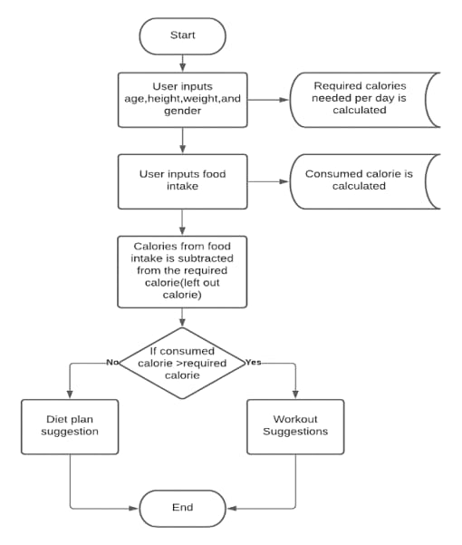
05
PYEXPO 2K24

Slide 6
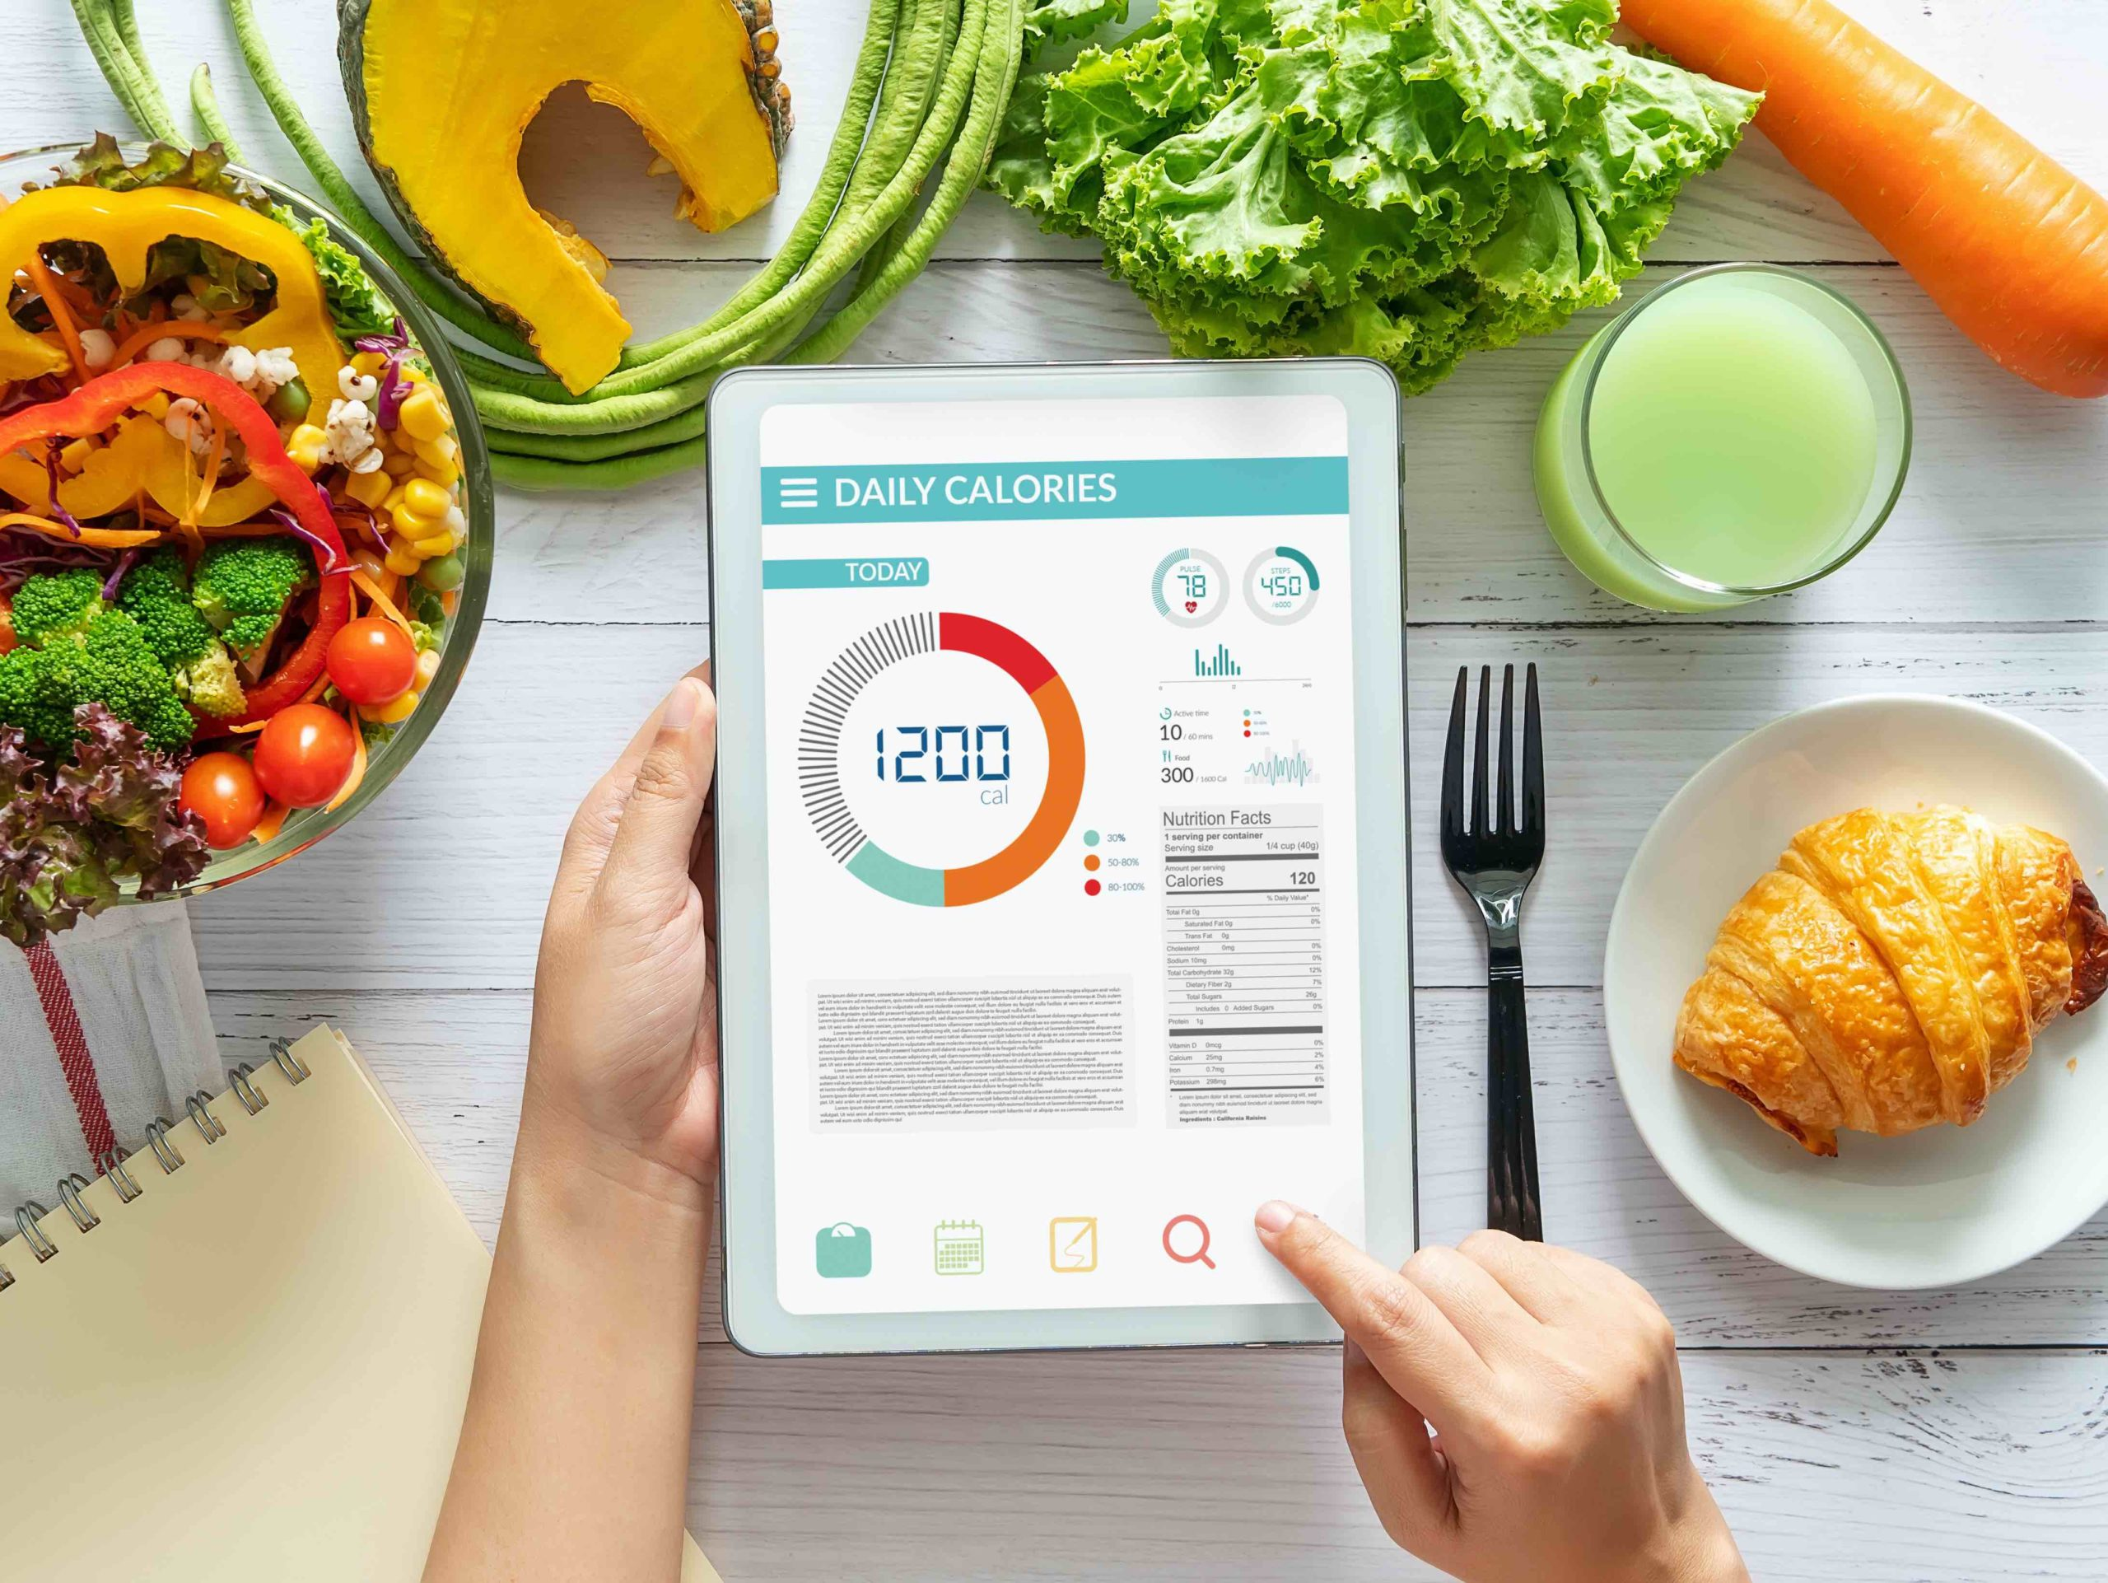

06
PYEXPO 2K24

Slide 7
Team Member Details:
Sivasundar J - 23aib37
Srihari S - 23aib39
Srijith S - 23aib40
Priyadharsan P - 23aib07
Ilaya raja – 23me19
07
PYEXPO 2K24

Slide 8
Thank You
PYEXPO 2K24

